Slide 1

Medi-Fit
Tailored health solutions for every individual.
Name / KTJ-ID / Contact Number :
Debrup Ghosh : 25KTJDEB597253 - 98276 61515
Abhishek Mishra : 25KTJABH123834 - 81447 51656
Aditi Lal : 25KTJADI871736 - 91024 03292
Asmet Sahoo : 25KTJASM460774 - 8917544609
College : Kalinga Institute of Industrial Technology

Slide 2

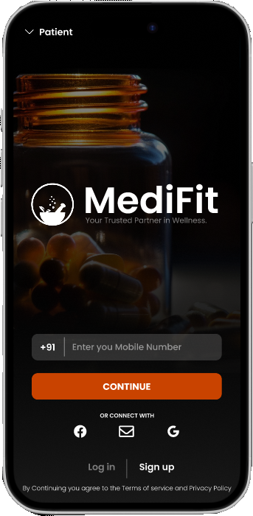
THE TOPIC OF THE PLAN
In the healthcare industry, issues like accessibility, organization, and affordability create significant barriers for many people, particularly those in rural or low-income areas, where maintaining good health often feels unattainable due to limited resources.
To address these challenges, we are developing MediFit, an innovative healthcare app designed to make quality health services accessible and affordable for all. MediFit will serve as a comprehensive health management tool, allowing users to store their health data, receive lifestyle assessments, and access affordable healthcare recommendations. Through partnerships with NGOs and hospitals, MediFit will help bridge the healthcare gap, offering options for those who may not have access to premium medical services.
Our mission with MediFit is to create a healthier world by ensuring that essential healthcare resources are within reach for everyone, regardless of financial background.

Slide 3
MISSION & VISION STATEMENT
Vision
To make healthcare accessible, organized, and affordable for all, regardless of geographic location or financial status, by leveraging technology and community partnerships.
Mission
MediFit is dedicated to empowering individuals to take charge of their health by providing a user-friendly platform that stores health data, offers lifestyle assessments, and connects users with affordable healthcare options. By collaborating with NGOs, hospitals, and other healthcare providers, MediFit aims to bridge the healthcare gap for underserved communities and make high-quality health services accessible to everyone.
Empower Users
Provide individuals with a user-friendly platform to track, store, and understand their health data, making heath management easy and accessible.
01.
Promote Affordable Healthcare
Partner with NGOs and healthcare providers to offer affordable, high-quality healthcare options tailored to individuals’ needs and financial situations.
02.
Enhance Accessibility
Ensure that people in rural and low-income areas have access to critical health resources, enabling better health outcomes for all.
03.

Slide 4
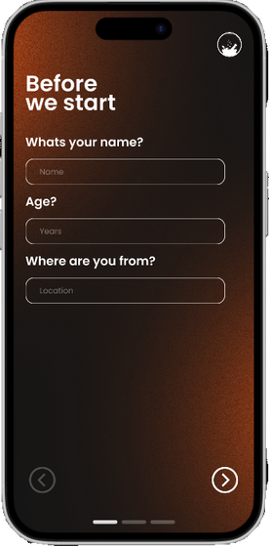
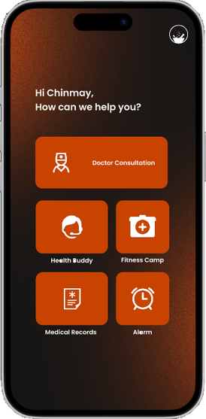
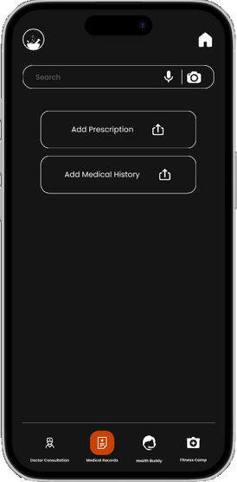
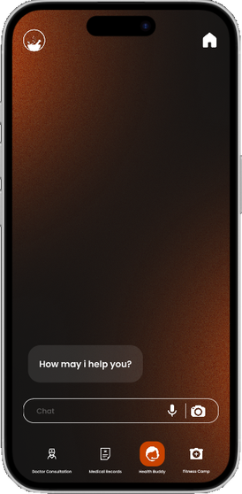
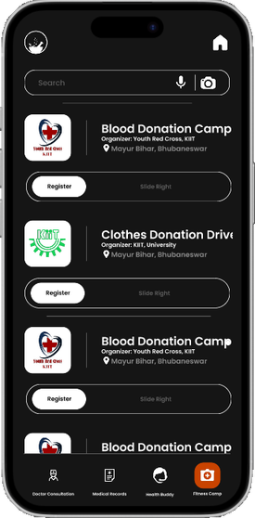
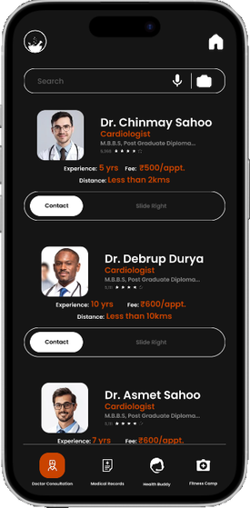
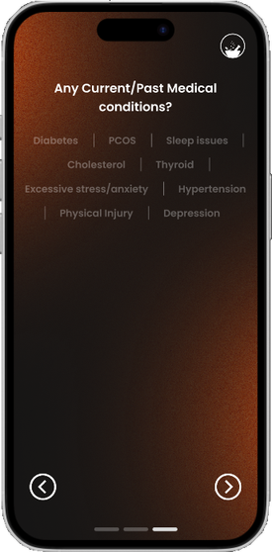
USER-INTERFACE(UI) OF MEDI-FIT

Slide 5
OVERVIEW OF MARKETING STRATERGY
1. Target Audience Identification
2. Value Proposition
3. Channels of Marketing
- Accessibility to affordable healthcare solutions.
- Simplified health data management and personalized lifestyle assessments.
- Bridging the healthcare gap through partnerships with NGOs and hospitals.
- Digital Marketing:
- Social Media Campaigns: Use platforms like Facebook, Instagram, and Twitter to share success stories, health tips, and app features.
- SEO and Content Marketing: Create a blog with health-related articles to drive organic traffic.
- Influencer Partnerships: Collaborate with healthcare influencers and bloggers to reach a broader audience.
- Community Engagement:
- NGO Partnerships: Work with NGOs to promote MediFit within communities.
- Health Camps and Workshops: Organize free health camps and workshops in rural areas to demonstrate the app’s benefits.
- Traditional Marketing:
- Print Media: Advertise in local newspapers and health magazines.
- Radio and Television: Use local radio and TV channels to reach a wider audience.
- Demographics: Primarily low-income individuals, rural populations, and elderly people.
- Psychographics: People who are seeking affordable healthcare solutions, value health data management, and are inclined towards technology.

Slide 6
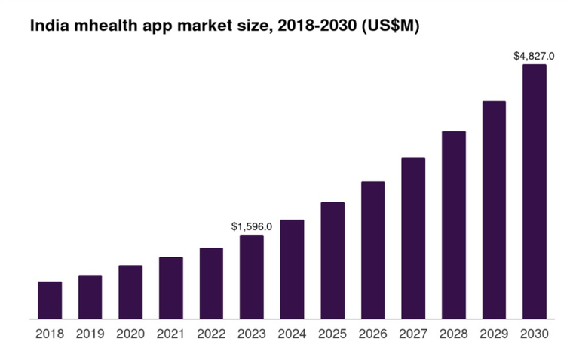
OVERVIEW OF SALES STRATERGY
1. Partnerships
- NGOs and Hospitals: Partner with NGOs and hospitals to offer MediFit as part of their health services.
- Corporates: Collaborate with companies to offer MediFit as a health benefit to their employees.
2. Freemium Model
- Offer basic features of MediFit for free to attract users.
- This app offers a freemium model to support individuals who cannot afford the membership. By submitting relevant documents, eligible users can access the app for free, ensuring it remains accessible to everyone.
3. Referral Programs
4. User Support
5. Promotional Offers
- Encourage existing users to refer MediFit to their friends and family by offering incentives such as discounts on premium features.
- Provide 24/7 customer support to assist users with any issues or questions they may have.
- Regularly update the app with new features and improvements based on user feedback.
- Run special promotions during health-related awareness campaigns, such as World Health Day.

Slide 7
COMPETITIVE ADVANTAGE
1. Accessibility
3. Affordability
- Targeting Underserved Communities: MediFit focuses on making healthcare accessible to low-income individuals and rural populations who often lack access to quality healthcare services.
- Partnerships with NGOs and Hospitals: Collaborations with NGOs and hospitals help bridge the healthcare gap and provide affordable healthcare options.
- Freemium Model: MediFit offers basic features for free, making it accessible to a wider audience.
- Subscription-Based Premium Features: Additional features are available through a subscription, providing users with more advanced health management tools.
4. Community Engagement
2. Comprehensive Health Management
- User-Friendly Platform: MediFit offers a user-friendly interface that allows users to store health data, receive lifestyle assessments, and access healthcare recommendations.
- Personalized Health Plans: The app provides personalized health plans based on individual health data, helping users manage their health more effectively.
- Health Camps and Workshops: MediFit organizes health camps and workshops in rural and underserved areas to demonstrate the app’s benefits and educate the community about health management.
- Local Influencer Partnerships: Collaborating with local health advocates helps build trust and credibility within communities.

Slide 8
COMPETITIVE ADVANTAGE
5. Technology Integration
- Real-Time Communication: MediFit integrates various stakeholders within the healthcare sector through digital solutions, enabling real-time communication between users, NGOs, hospitals, and insurance companies.
- Cloud-Based Platform: The app uses cloud-based platforms to facilitate health assistance services and ensure data security.
7. Ease of Implementation and Usage
-Implementation: MediFit's cloud-based platform ensures easy deployment and robust data security. Partnerships with NGOs and hospitals facilitate seamless integration and broaden the app's reach.
-Usage: The app's intuitive interface, multilingual support, and real-time communication features make it accessible for users of all technical levels. Users can track health metrics, access telemedicine services, and receive personalized health insights. Integration with wearable devices and emergency response features enhance convenience and safety.
6. Focus on Chronic Health Conditions
- Tailored Fitness Monitoring: MediFit specializes in providing tailored fitness monitoring solutions for individuals with chronic health conditions, helping them manage their health and prevent complications.
By leveraging these competitive advantages, MediFit can effectively differentiate itself in the healthcare mobile applications market and make a significant impact on healthcare accessibility and affordability.

